Slide 1


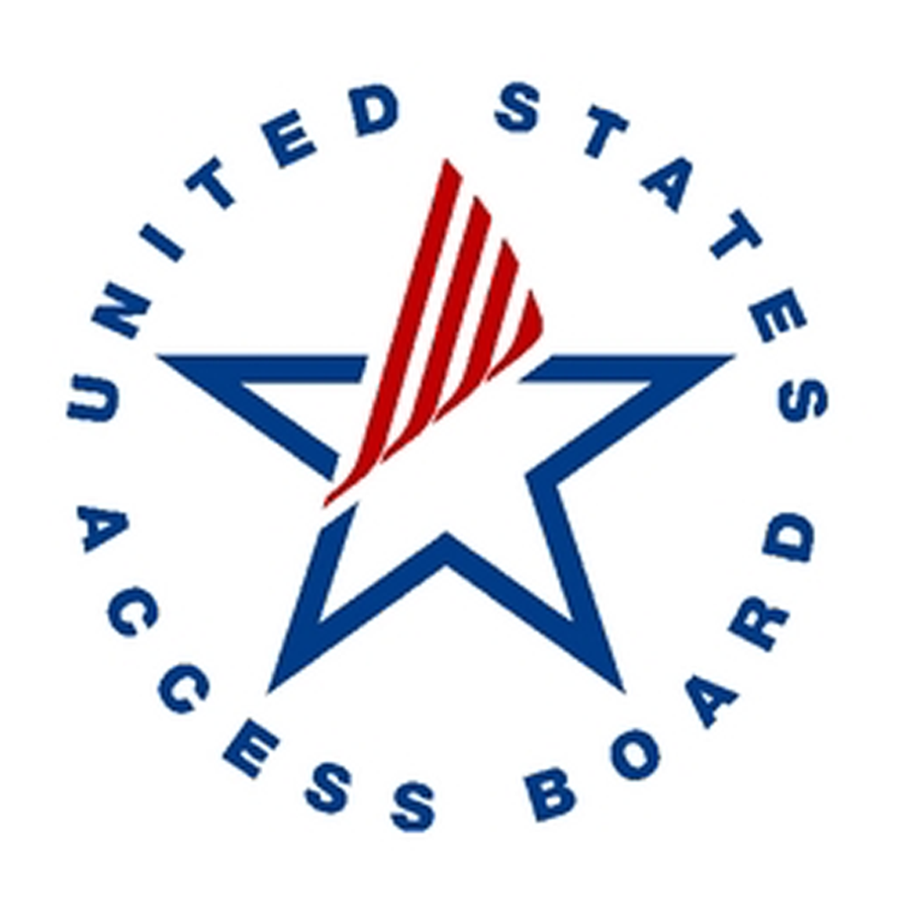


Annual Interagency Accessibility Forum
Beyond Compliance: Building a Culture of Digital Accessibility
November 7-9, 2023
Testing Tools and Ease of Access
November 7, 2023

Slide 2

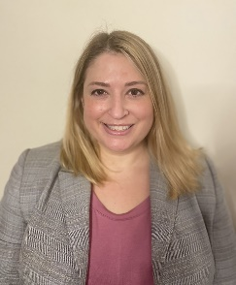

Section 508 Team Presenters​
Brooke Aiken​
FDIC Section 508 Program Manager​
Jennifer Meltz​
Section 508 Specialist​
Danny Guzman
Section 508 Specialist​
Brooke Aiken
FDIC Section 508 Program Manager
Jennifer Meltz
Section 508 Support
Danny Guzman
Section 508 Support

Slide 3

Agenda
Ease of Access in Windows ​
Screen Readers (NVDA & JAWS) ​
Color Contrast Analyzer ​
Accessible Name & Description Inspector (ANDI) ​
Microsoft Accessibility Insights for Windows

Slide 4
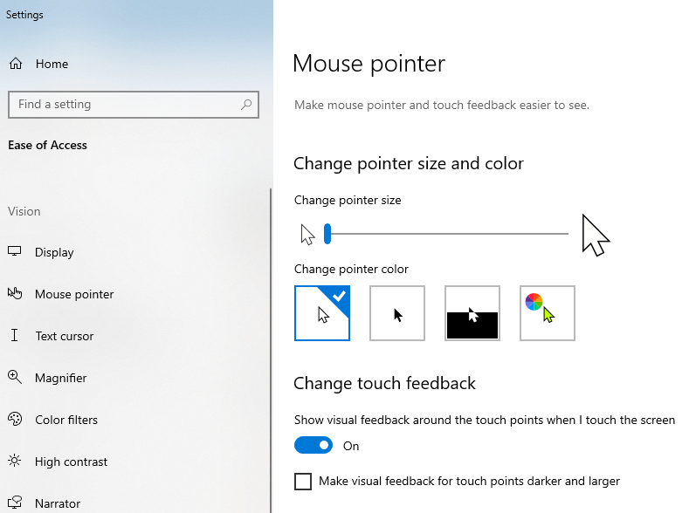
Ease of Access Windows Operating System​
In your search bar (bottom left)…type “Ease of Access”​
​
Options​
Vision​
Hearing​
Interaction ​
​
Demo

Slide 5
Screen readers​
JAWS (Job Access with Speech)​
Most popular screen reader​
Provides speech and braille output​
Free in a demo mode ​
JAWS specific keystrokes​
https://www.freedomscientific.com/products/software/jaws/
NVDA (NonVisual Desktop Access)​
Free screen reader​
NVDA specific keystrokes​
https://www.nvaccess.org/download/
Narrator (Ease of Access)​
Built in screen reader for the Windows platform

Slide 6
NVDA Keyboard Shortcuts
Headings: | Go to next heading | H
Headings: | Go to next heading of level [1-6] | 1 - 6
Headings: | List all headings | Insert + F7
Landmarks: | Go to next landmark/region | D
Elements list: | Show list of all links, headings, form fields, buttons, and landmarks | Insert + F7
Graphics: | Go to next graphic | G
Links: | List all links | Insert + F7
Links: | Go to next link | K
Links: | Go to next unvisited link | U
Links: | Go to next visited link | V

Slide 7
Good and bad Example of web sites​
Good example – Web Accessibility Initiative (WAI) Accessible Home Page
Bad example - Web Accessibility Initiative (WAI) Inaccessible Home Page

Slide 8
CCA (Color Contrast Analyzer)​
CCA (Color Contrast Analyzer) is a color contrast checker tool that allows you to easily determine the contrast ratio of two colors. The CCA enables you to optimize your content–including text and visual elements–for individuals with vision disabilities like color-blindness and low-vision impairments.
Use the WebAIM Color Contrast Checker to check your colors: https://www.dhs.gov/publication/web-accessibility-toolbar
To view a video on how to use the CCA (Color Contrast Analyzer), visit the site below: https://www.section508.gov/test/web-software/andi-training-videos/color-contrast-analyzer

Slide 9
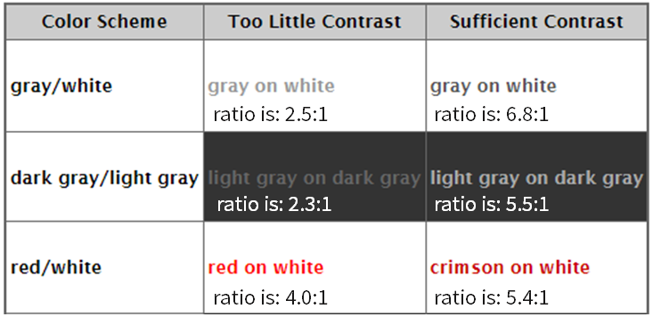
CCA (Color Contrast Analyzer) Example​
Demo Example:
Good vs Bad Color Contrast Example:
Insufficient Color Contrast

Slide 10
ANDI (Accessible Name & Description Inspector)​
ANDI (Accessible Name & Description Inspector) is a free tool to test web content for accessibility.​
ANDI is a "favelet" or "bookmarklet" that will:​
Provide automated detection of accessibility issues​
Reveal what a screen reader should say for interactive elements​
Give practical suggestions to improve accessibility and check 508 compliance​
​
For instructions on adding the current version of ANDI to your browser, visit the ANDI Installation Instructions page on the Social Security Administration (SSA.gov website).​
​
To view a series videos to explain and demonstrate how to use the Accessible Name & Description Inspector (ANDI) testing tool, visit the site below:​
https://www.section508.gov/test/web-software/andi-training-videos

Slide 11
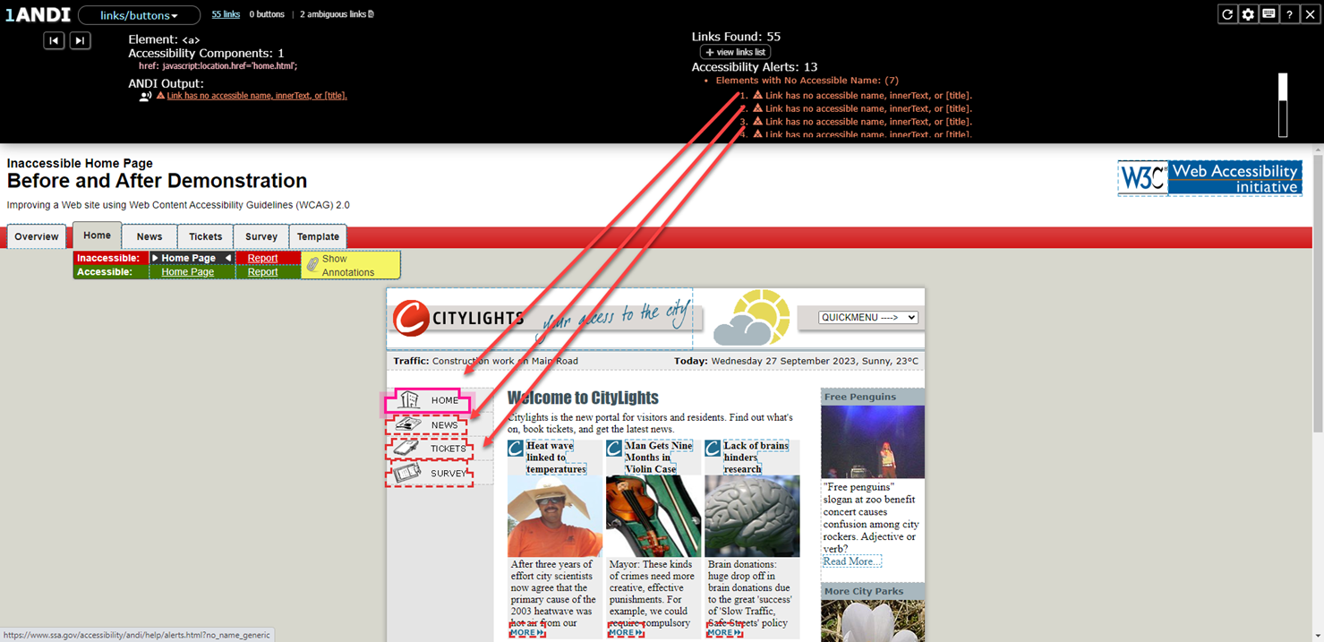
ANDI Screenshot​

Slide 12
Microsoft​ Accessibility Insights for Windows
Accessibility Insights for Windows is a free tool to test websites, apps, software programs and documents for accessibility.
Accessibility Insights is a standalone tool that supports:
Live Inspect lets users verify UI automation properties by hovering or focusing on elements.
FastPass is a lightweight scan that helps users identify accessibility issues in less than five minutes.
Provides guidance on how to fix issues according to Section 508 and WCAG Guidelines.
Troubleshooting allows you to diagnose and fix specific accessibility issues.
Use the built-in contrast checker to identify contrast issues.
For instructions on adding Microsoft Accessibility Insights for Windows to your laptop/desktop, visit the Microsoft Accessibility Insights Installation Instructions page on the Microsoft Accessibility Insights (https://accessibilityinsights.io/)

Slide 13
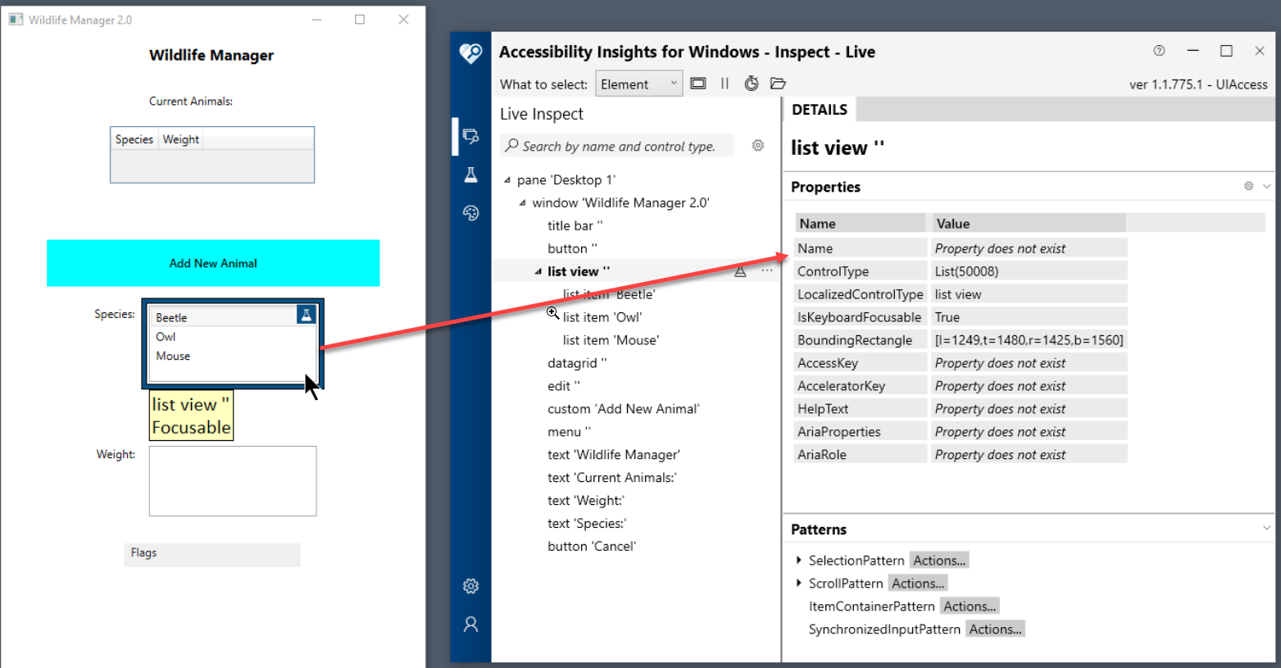

Microsoft​ Accessibility Insights Tool
Work Station Requirements
This desktop app runs on Windows computers.
Windows 10 Versions or higher.
For Reference:
https://accessibilityinsights.io/docs/windows/reference/faq/

Slide 14
Common Web Accessibility Issues
Common Issues:
Poor Keyboard Navigation
Inappropriate Alternative Text on Images
Using Non-descriptive Links/Buttons
Heading Hierarchy & List Structure
​Poor Contrast Text
Failure to Specify Language
Time-Outs Cannot Be Controlled
Additional information:
ICT Testing Baseline for web establishes the minimum tests for Section 508 conformance to be included in test methodologies for web content.
GSA Section 508 ICT Testing Baseline for Web
DHS Trusted Tester Section 508 Conformance Test Process for Web

Slide 15

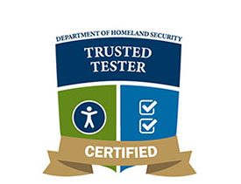
Department of Homeland Security Trusted Tester Program
Section 508 Certified Trusted Tester Program is a strategic solution with a three-pronged approach:
Promoting across the federal government common evaluation processes and procedures for Section 508 testing of Information and Communication Technology (ICT).
Increasing the workforce skillset and capability by implementing a certification program for Section 508 conformance testing.
Creating a central repository containing trusted tester test results that can be shared amongst government agencies to reduce redundant testing.
The DHS Trusted Tester Program is on Version 5.1 https://www.dhs.gov/508-testing

Slide 16

Questions?

